Slide 1
Distances computation

Slide 2
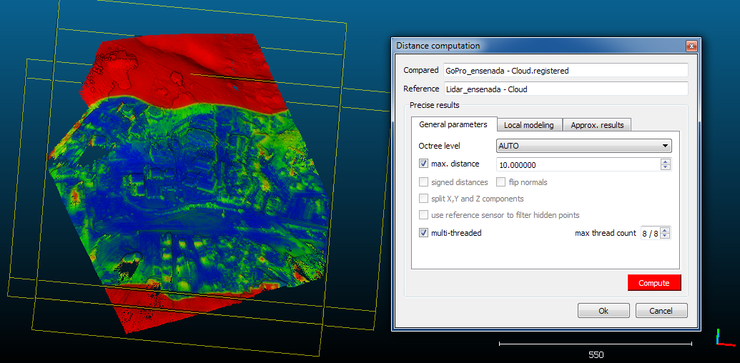
Cloud-cloud distances
Highlight two clouds and start the tool
(Tools > Distances > Cloud/Cloud dist.)
Choose the LIDAR cloud as reference
Define a maximum distance of 10 m. (acceleration)

Slide 3
Distances computation
By default, distances are computed between each point of the compared cloud and its nearest neighbor (point or triangle) in the reference entity
The process is not symmetrical!
compared
reference

Slide 4
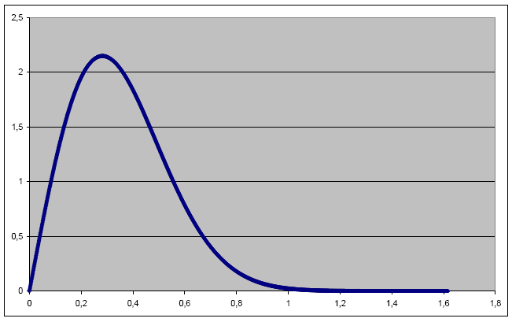
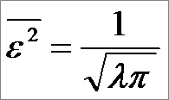
C2C distances computation
Main idea: if the reference cloud is dense enough, then the distance to the nearest neighbor is (almost) as precise as the true distance à to the real-world surface represented by the cloud
Theory: TLS cloud sampling follows
a Poisson distribution
  error is bounded
  error depends only on the cloud
  density
Always use the most dense cloud
as reference (if possible)
Extents of the reference cloud should be at least as wide as the compared cloud (avoid non-overlapping areas)
N.N. distances in a random Poisson process

Slide 5
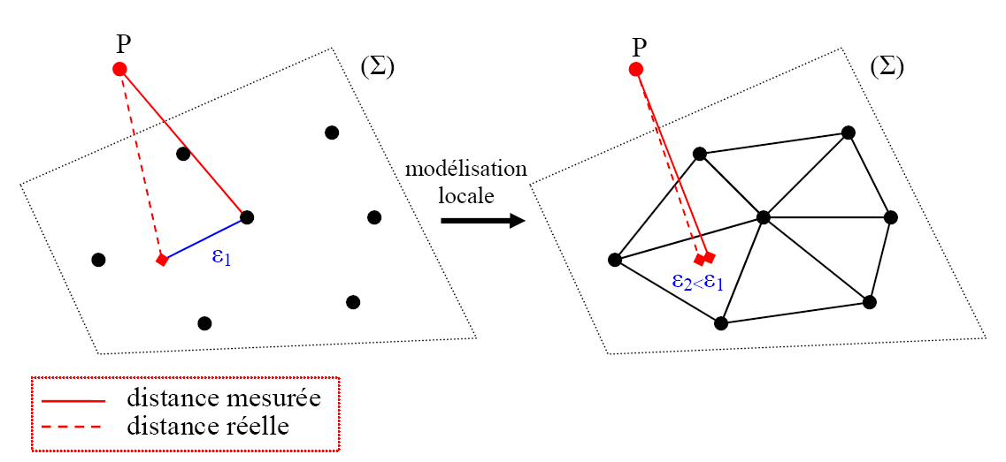
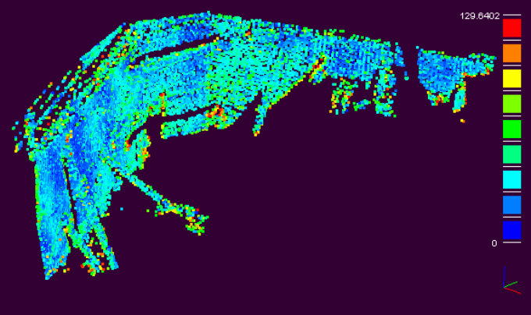
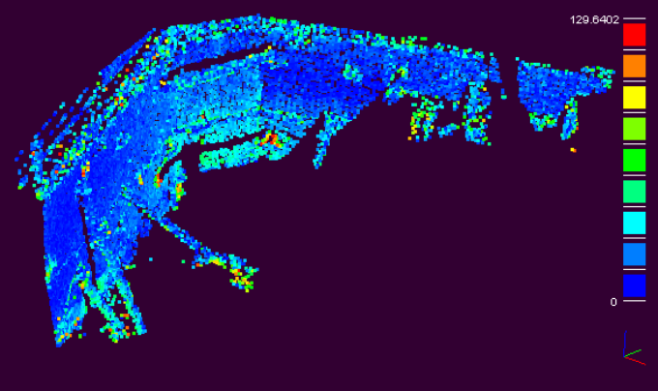
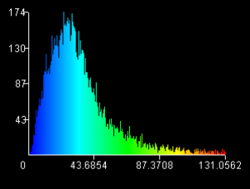
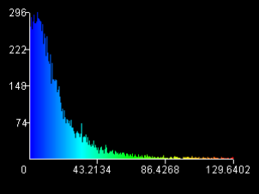
Poor or irregular density?
Local modelling strategies
ε
measured distance
real distance
Local modelling
(2 to 5X slower)

Slide 6
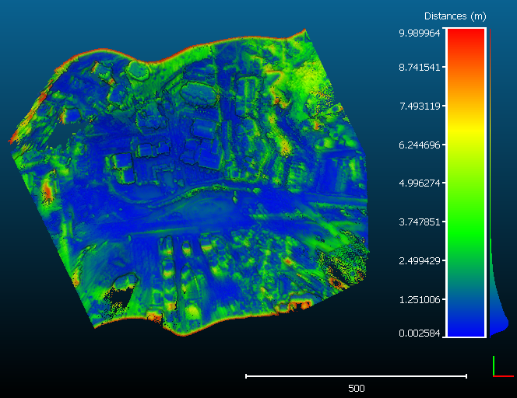
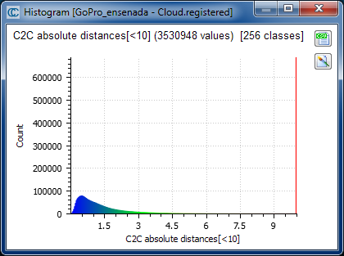
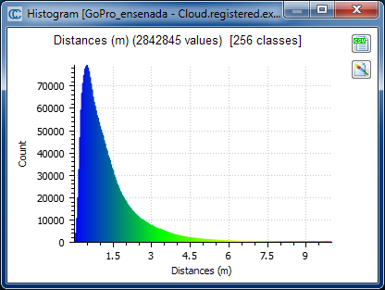

Statistics
Highlight the GoPro cloud and start the tool
(Edit > Scalar fields > Show histogram)
Histogram is polluted by far / red points (> 10 m.)
Use the tool (Edit > Scalar fields > Filter by value) and keep points inside [0 9.99]
Highlight the resulting cloud
  display the histogram
  Display the associated color ramp
  (section ‘Color Scale’ / option ‘Visible’)
  rename the scalar fied
  (Edit > Scalar fields > Rename)
  + other manipulations

Slide 7
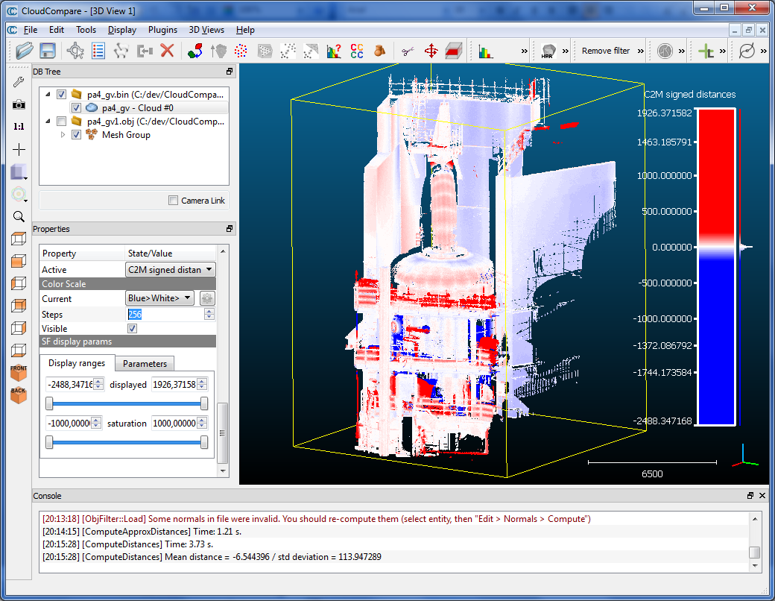
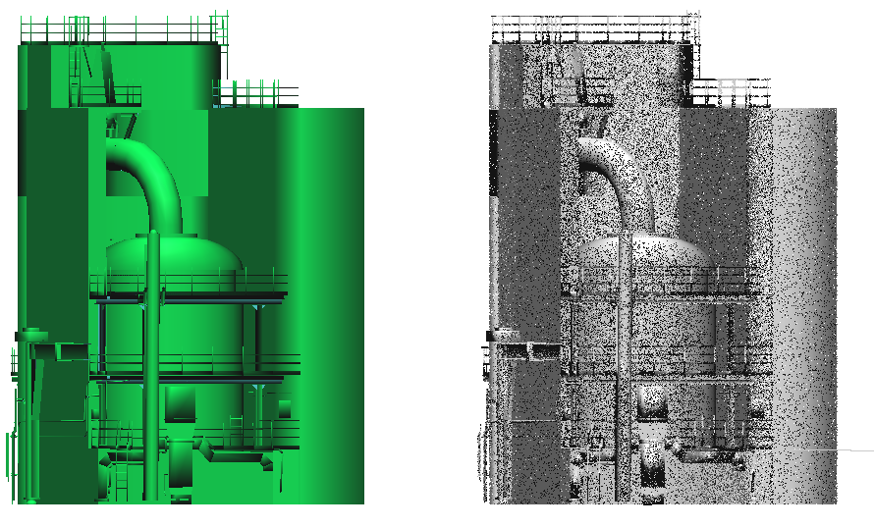
Cloud-to-mesh distances
Tools > Distances > Cloud/Mesh dist.
  distance from each point of the compared cloud to the nearest triangle in the reference mesh (the mesh is chosen as reference automatically)
  Generally more robust, faster and accurate… if the mesh quality is good!
  Other advantage: signed distances
  To compare two meshes: use either the compared mesh vertices or sample a lot of points on the compared mesh

Slide 8
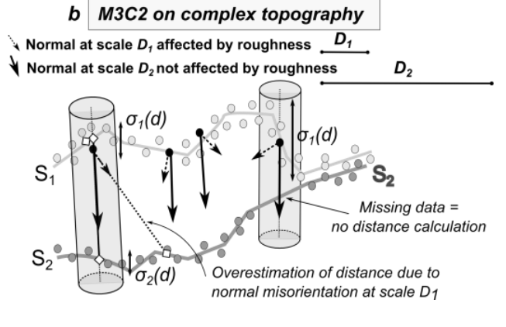
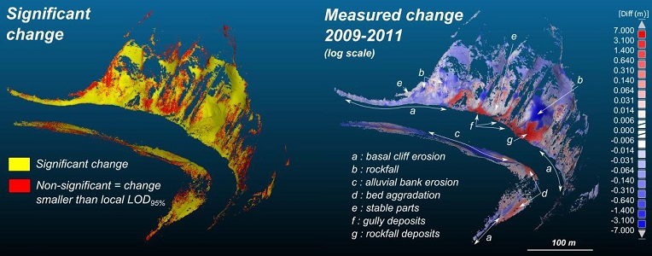
Advanced C2C: the M3C2 plugin
Lague, D., Brodu, N. and Leroux, J., Accurate 3D comparison of complex topography with terrestrial laser scanner : application to the Rangitikei canyon (N-Z), 2013, ISPRS journal of Photogrammmetry and Remote Sensing

